Slide 1
Emotion Recognition
Gavin Jones & Cody Mott

Slide 2
Problem Statement
Develop a CNN model capable of accurately and efficiently detecting human emotions from facial expressions. Our goal was to create a model that enhances our understanding of human emotions through facial cues.

Slide 3
Our Dataset
FER-2013 (Facial Emotion Recognition)
Our dataset contained 35,886 images of faces labeled with one of 7 different emotions
The emotions included: Anger, Disgust, Fear, Happiness, Sadness, Surprise, and Neutral
48x48x1 Images
70% train data, 20% validation data, 10% test data

Slide 4
Data Preprocessing
Load data using pandas read_csv() function
Dropped unnecessary columns
Converted String formatted images into array format
Separate labels and images into different arrays
Normalize images
One-hot encoded labels
Split into train, test, and validation sets

Slide 5
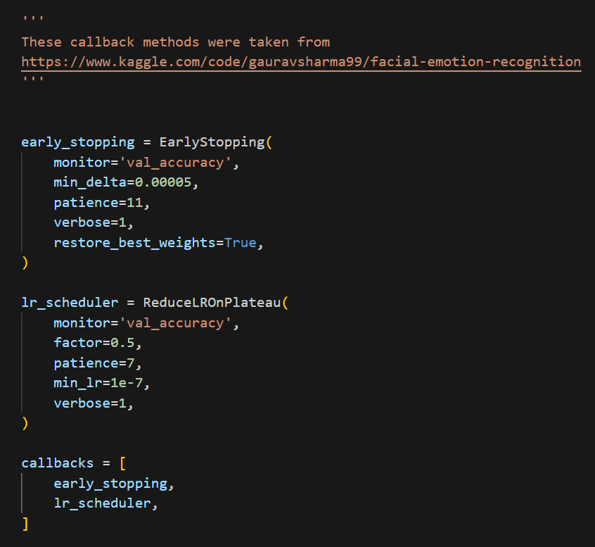
Training Parameters
Baseline Model
Epochs = 20
Batch Size = 32
Improved Model V1
Epochs = 100
Batch Size = 64
Improved Model V2
Callback functions
EarlyStopping
LearningRate Scheduler
Epochs = 100
Batch Size = 128

Slide 6
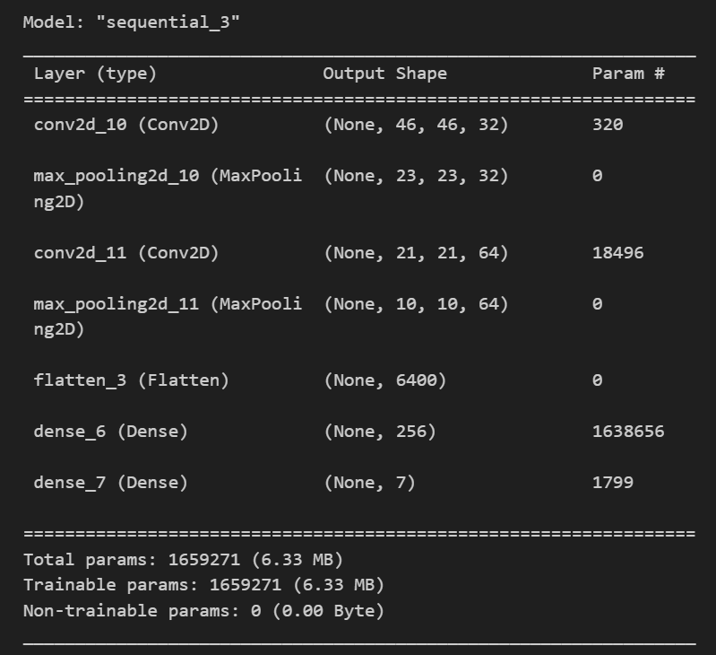
Baseline Model
Convolutional Layers: 2
Filters: 32, 64
‘relu’ activation function
MaxPooling2D added
Flatten Layer
Dense Layer
Filter: 256
‘relu’ activation function
7 Output classes
‘softmax’ activation function
Optimizer
learning rate = 0.001
Loss = ‘categorical_crossentropy’

Slide 7
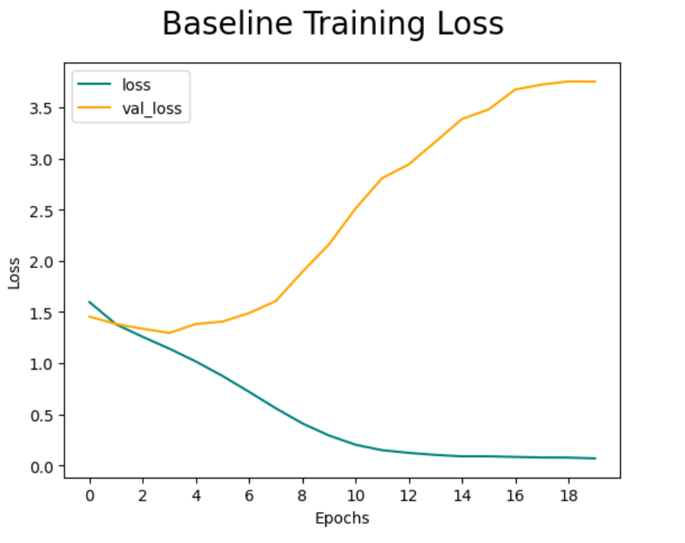
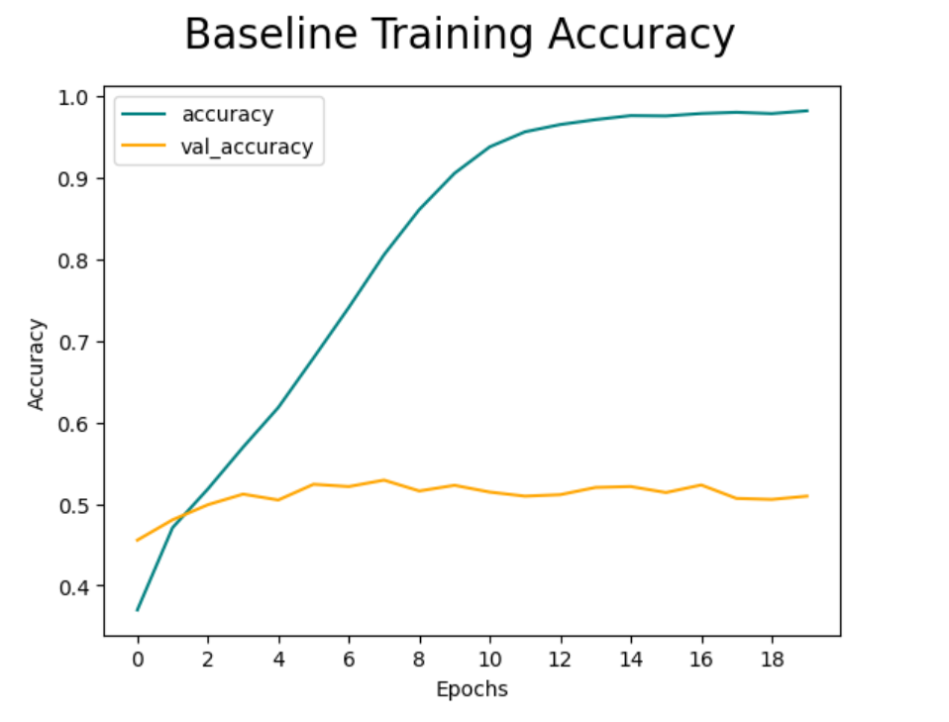
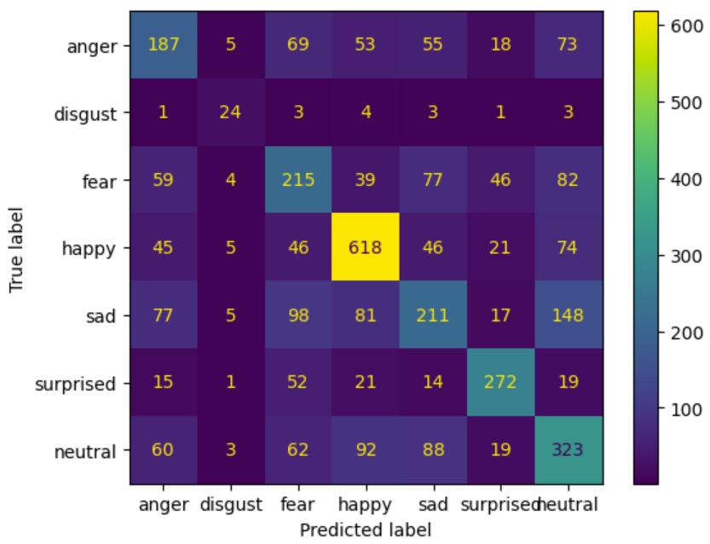
Base Model Results
Test Accuracy: 51.94%

Slide 8
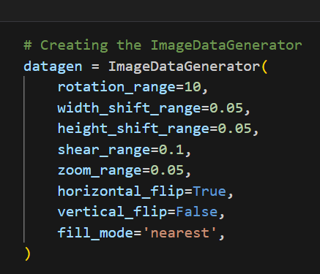
Data Augmentation
Significant difference in category amounts
Calculate difference in amounts
Create an ImageDataGenerator
Define function to augment the data for each category
Now the train data has equal amounts
Concatenate new augmented images with original images

Slide 9
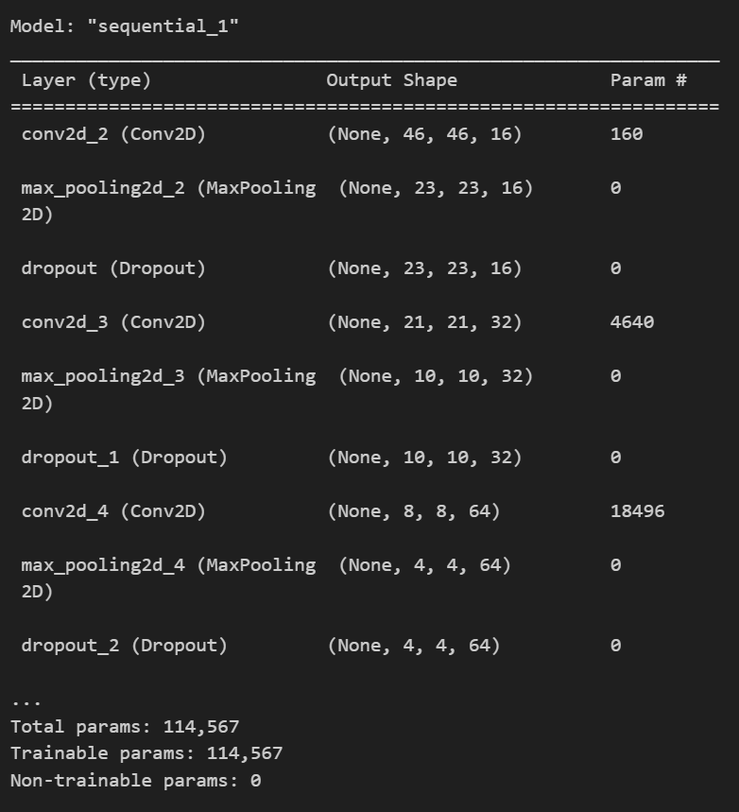
Improved Model v1
Convolutional Layers: 4
Filters: 16, 32, 64, 128
‘leaky_relu’ activation function
MaxPooling2D added
Dropout of 0.25 for each layer
Flatten Layer
Dense Layer
Filter: 128
‘leaky_relu’ activation function
Dropout 0.25
7 Output classes
‘softmax’ activation function
Optimizer
learning rate = 0.001
Loss = ‘categorical_crossentropy’

Slide 10
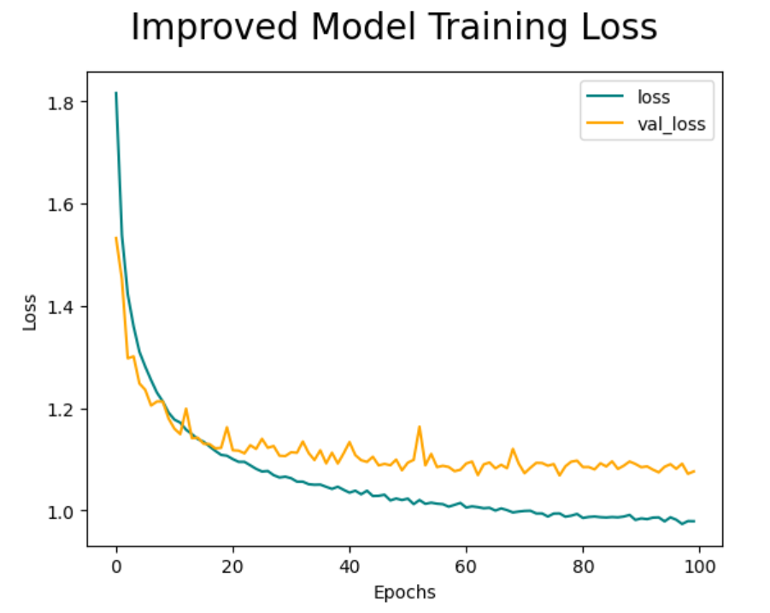
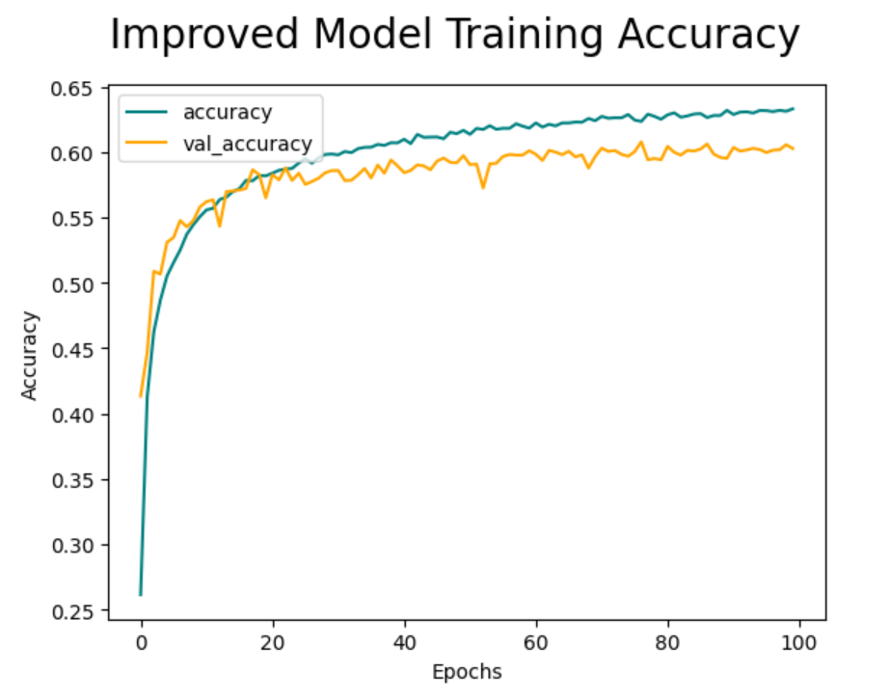
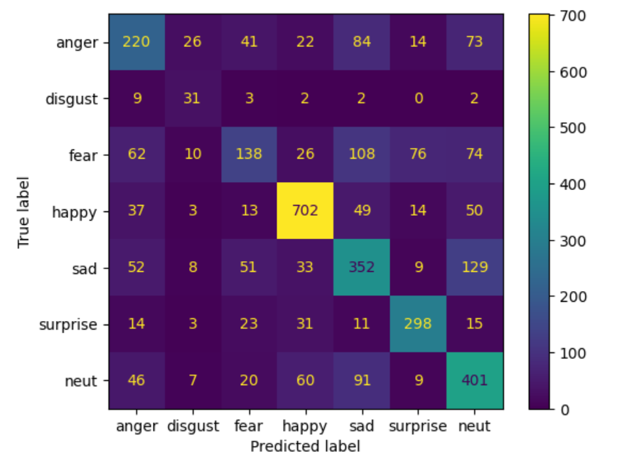
Data Augmentation Results
Test Accuracy: 60.27%

Slide 11
Downsampling
Drop Category 1: ‘disgust’
Drop Category 6: ‘neutral’
Downsample Category 3: ‘happy’
Combine downsampled category with other data
Resplit the data into training, testing, and validation

Slide 12
Improved Model v2
Convolution Layer Set: 4
Convolution
Filters: 16, 32, 64, 128
Kernel Size: 3x3
Weight Normalization: ‘glorot_normal’
Batch Normalization
Activation
Activation Function: ‘leaky_relu’
Max Pooling
Dropout
25%
Flatten
Dense Layers: 4
Dense 1
Outputs: 128
Activation Function: ‘leaky_relu’
Dropout
25%
Dense 2
Outputs: 5
Activation Function: ‘softmax’
Optimizer
Adam
Learning Rate: 0.001
Loss
Loss Function: ‘categorical_crossentropy’

Slide 13
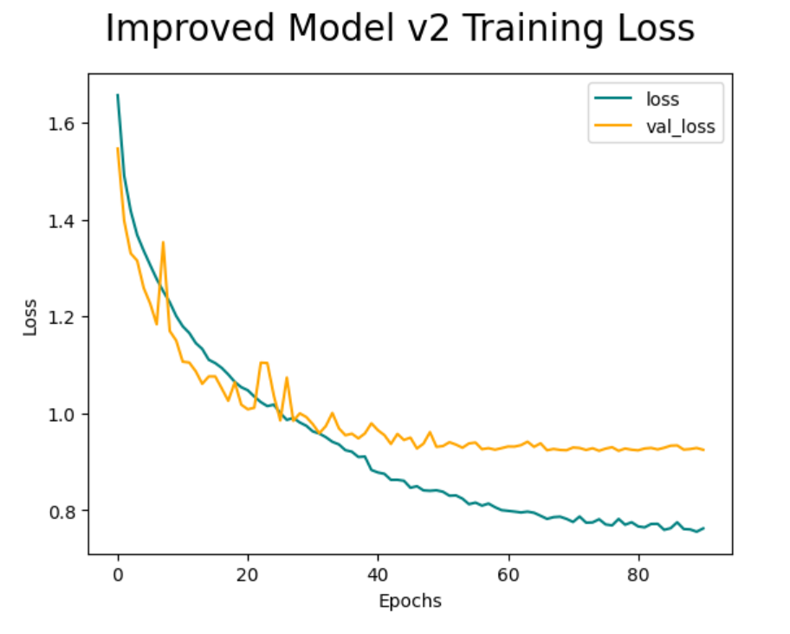
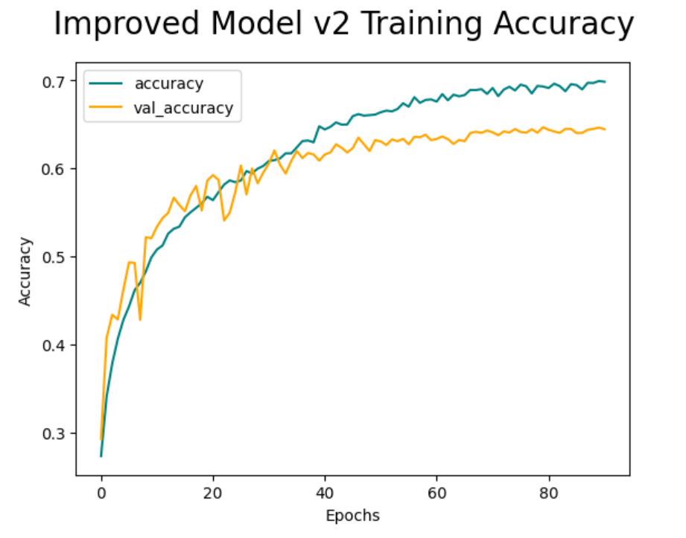
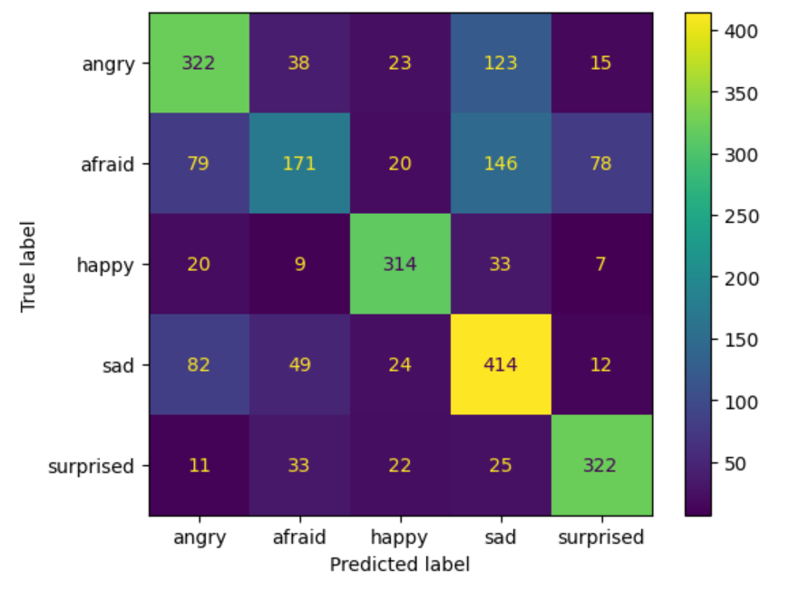
Removed Data Results
Test Accuracy: 64.51%

Slide 14
Dataset Issues
Imbalanced distribution of data
Images with watermarks
Hands covering faces
Babies
Cartoons
Face not visible

Slide 15
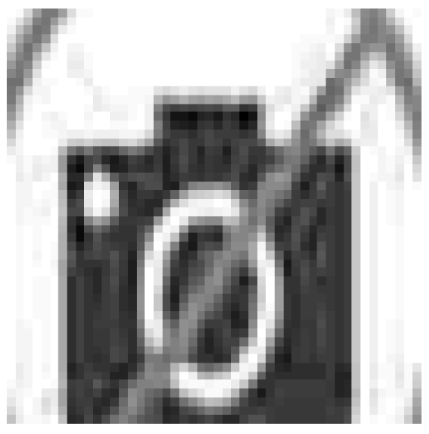
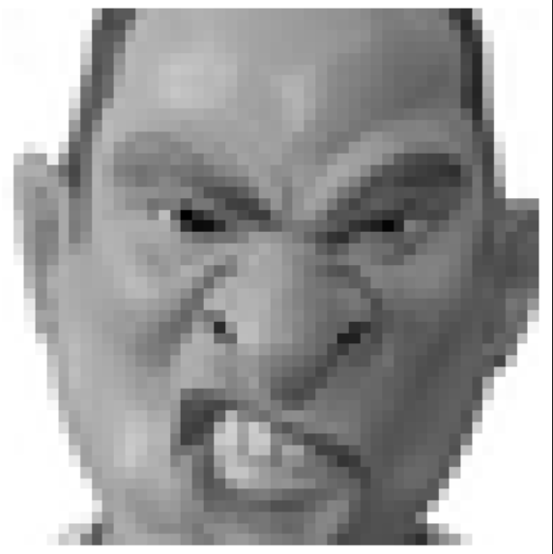
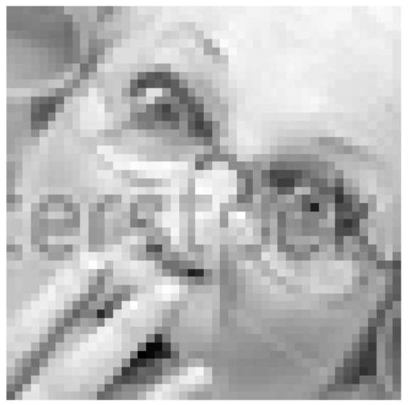
Examples

Slide 16
Future Improvements
New/Curated Dataset
More Testing of Hyperparameters
Compare to DNN model

